Slide 1
Dataproc vs Dataflow
Presented by – Gaurav Pasupuleti

Slide 2
Functionalities of the components
Cloud Dataproc
Cloud Dataflow
Dataproc is a managed Spark and Hadoop service that lets you take advantage of open source data tools for batch processing, querying, and machine learning.
Dataproc automation helps you create clusters quickly, manage them easily, and save money by turning clusters off when you don't need them. With less time and money spent on administration
Spin up an autoscaling cluster in 90 seconds on custom machines
Build fully managed Apache Spark, Apache Hadoop, Presto, Hive, and other OSS clusters
Encryption and unified security built into every cluster
Autoscaling of nodes (Use of preemptible VM’s might save some additional expenditure)
Accelerate data science with purpose-built clusters you can focus on your jobs and your data.
Unified stream and batch data processing that's serverless, fast, and cost-effective.
Fully managed data processing service
Automated provisioning and management of processing resources
Horizontal autoscaling of worker resources to maximize resource utilization
OSS community-driven innovation with Apache Beam SDK
Reliable and consistent exactly-once processing.
The service is serverless, hence no Ops is required.

Slide 3
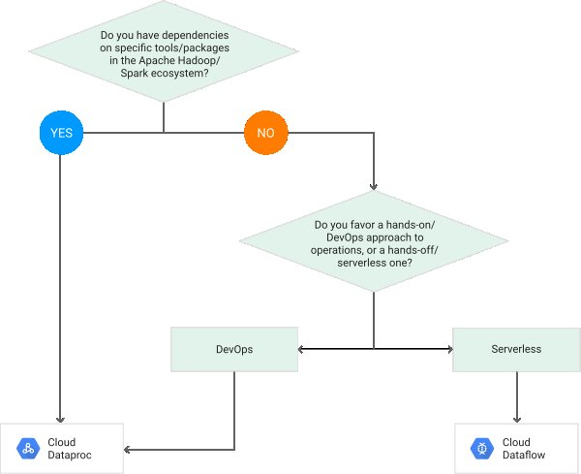
Decision tree (Dataproc vs dataflow)

Slide 4
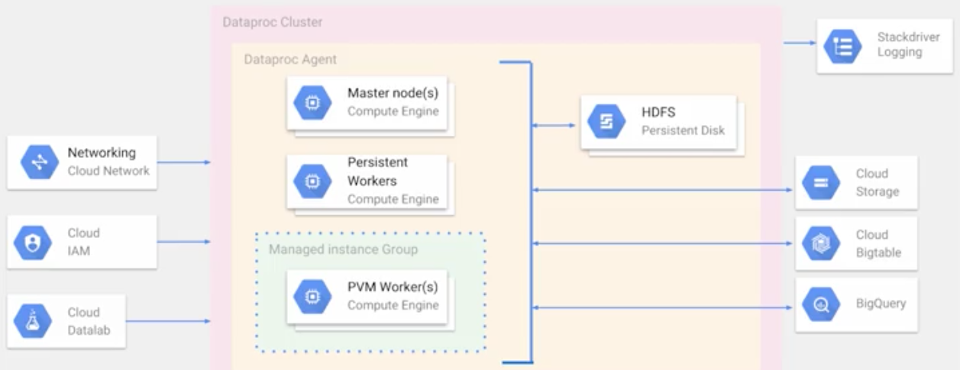
Dataproc Architecture

Slide 5
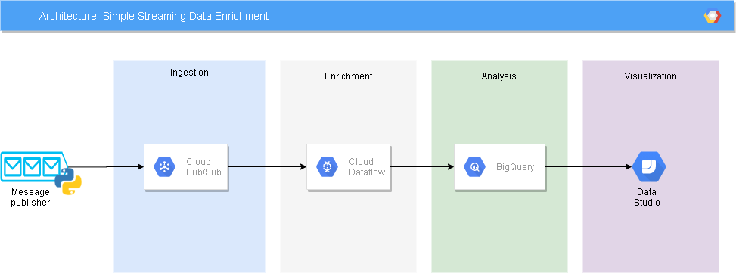
Dataflow Architecture

Slide 6
Use cases (Dataproc)
Migrating Apache Spark Jobs to Dataproc
https://cloud.google.com/solutions/migration/hadoop/migrating-apache-spark-jobs-to-cloud-dataproc
Using Apache Hive on Dataproc
https://cloud.google.com/solutions/using-apache-hive-on-cloud-dataproc
Migrating data warehouses to BigQuery: Data pipelines
https://cloud.google.com/solutions/migration/dw2bq/dw-bq-data-pipelines

Slide 7
Use cases (dataflow)
Building production-ready data pipelines using Dataflow: Planning data pipelines
https://cloud.google.com/solutions/building-production-ready-data-pipelines-using-dataflow-planning
Performing ETL from a relational database into BigQuery using Dataflow
https://cloud.google.com/solutions/performing-etl-from-relational-database-into-bigquery

Slide 8
Alternatives available in the market
Dataproc
Dataflow
AWS – EMR (Elastic MapReduce)
Azure – HDInsight
On Premises Hadoop cluster
Hewlett Packard Enterprise - MapR
AWS – Kinesis
Spark Streaming
Kafka

Slide 9
Thank you
Any Questions?

